Slide 1




prioritizr Systematic conservation planning in R R
Session 2
Jeffrey Hanson
jeffrey.hanson@uqconnect.edu.au
prioritizr.net

Slide 2





Reserve selection as optimization
Goal: conserve biodiversity
Objective: min. # of islands
Constraints: sufficient habitat for each species
Decisions: create a reserve on an island or not?

Slide 3
Reserve selection as optimization
Goal: conserve biodiversity
Objective: min. # of islands
Constraints: sufficient habitat for each species
Decisions: create a reserve on an island or not?

Slide 4

prioritizr
Human readable code
Design your problem
Solve it fast!

Slide 5


Objective
Minimize cost

Slide 6

Objective
Maximize benefit

Slide 7
Objective
Maximize benefit

Slide 8
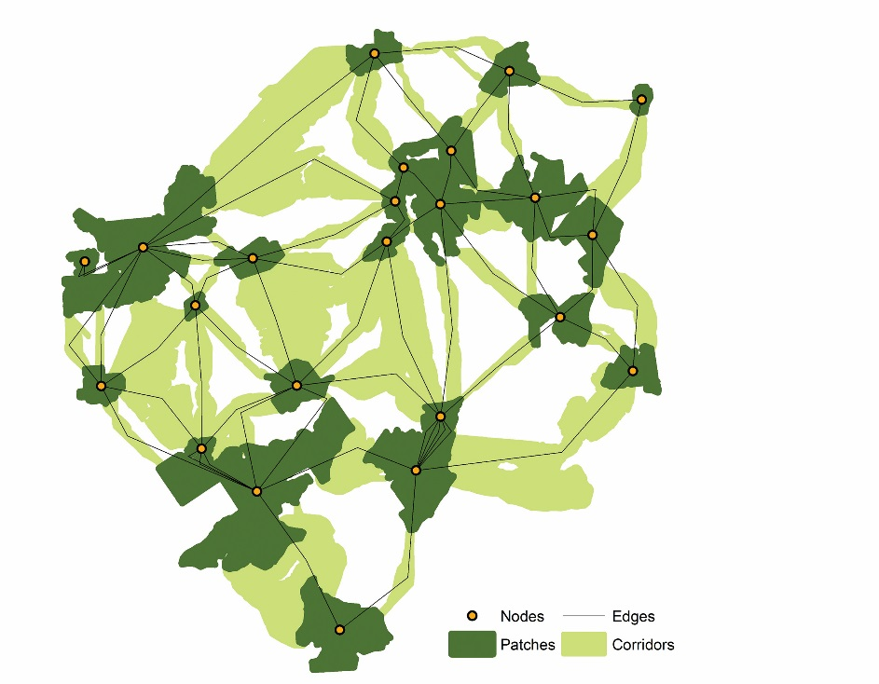
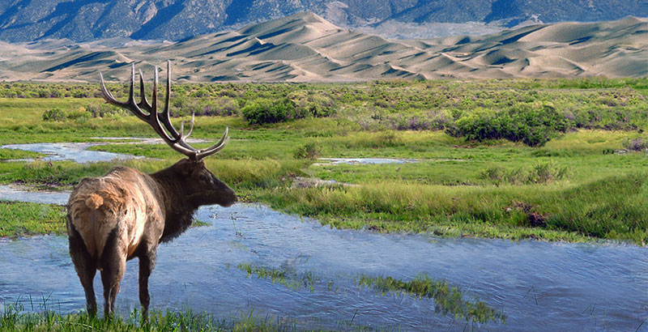
Constraints & Penalties

Slide 9
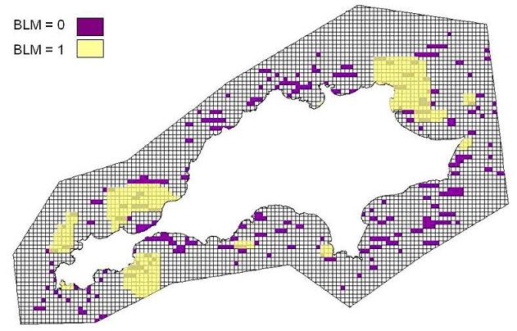
Constraints & Penalties

Slide 10
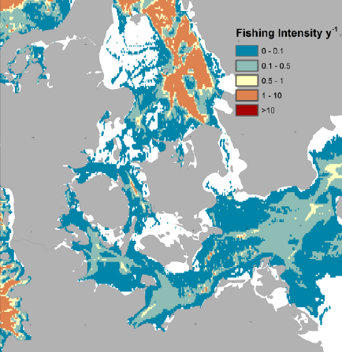
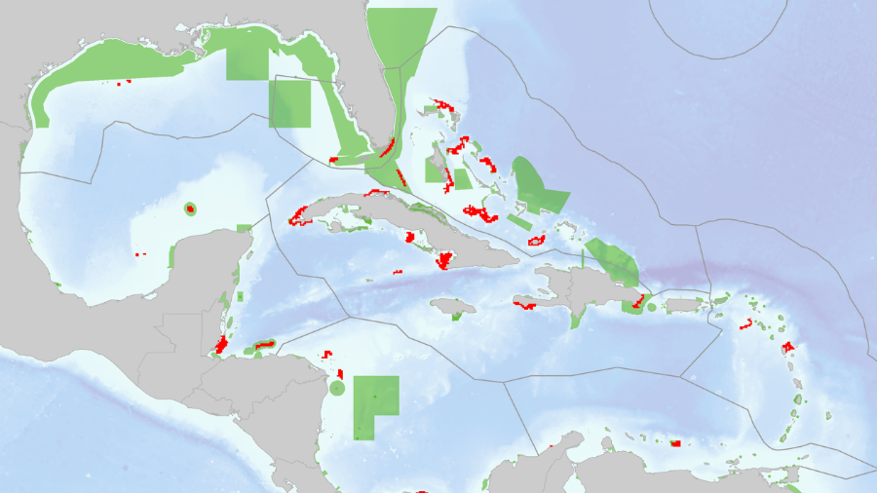
Constraints & Penalties

Slide 11
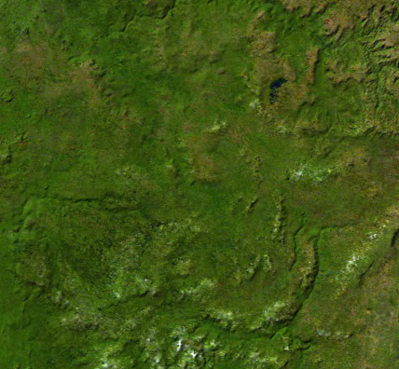
Decision type
Conserve or not?
Different amounts?
Multiple actions?

Slide 12





Solver
?
?
?
?

Slide 13
Package Workflow
Biodiversity data
Input data for solver
Economic data
Solve problem
Problem formulation
Maps
Statistics

Slide 14
Package Workflow
Biodiversity data
Input data for solver
Economic data
Solve problem
Problem formulation
Maps
Statistics

Slide 15
Package workflow
Biodiversity data
Input data for solver
Economic data
Solve problem
Problem formulation
Maps
Statistics

Slide 16
Human-readable code
Mental model
problem <- data +
objective +
constraints +
penalties +
decision type +
solver
solution <- solve(problem)

Slide 17
Human-readable code
Mental model
Code
problem <- data +
objective +
constraints +
penalties +
decision type +
solver
solution <- solve(problem)
p <- problem(areas, feats) %>%
add_min_set_objective() %>%
add_relative_targets(0.1) %>%
add_boundary_penalties(5) %>%
add_binary_decisions() %>%
add_rsymphony_solver()
solution <- solve(p)

Slide 18
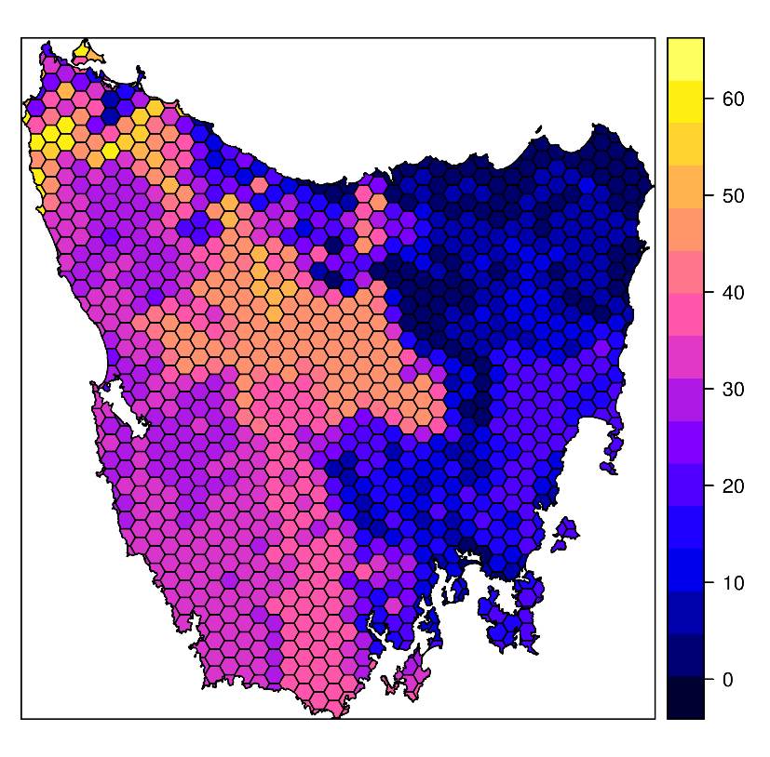
Design your problem
Study area: Tasmania, Australia
Planning units: 1130 hexagons
Features: 63 vegetation types

Slide 19
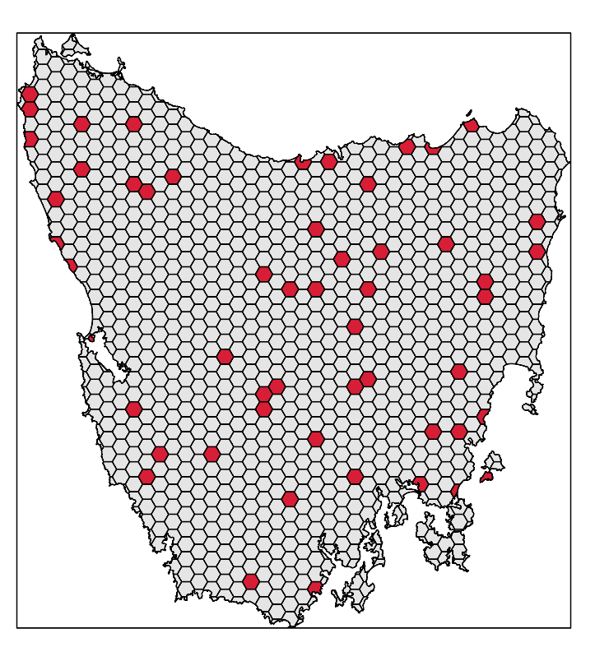
Design your problem
problem(tas_pu, tas_features,
"cost") %>%
add_min_set_objective() %>%
add_relative_targets(0.1) %>% add_binary_decisions() %>%
add_gurobi_solver(gap = 0) %>% solve()

Slide 20
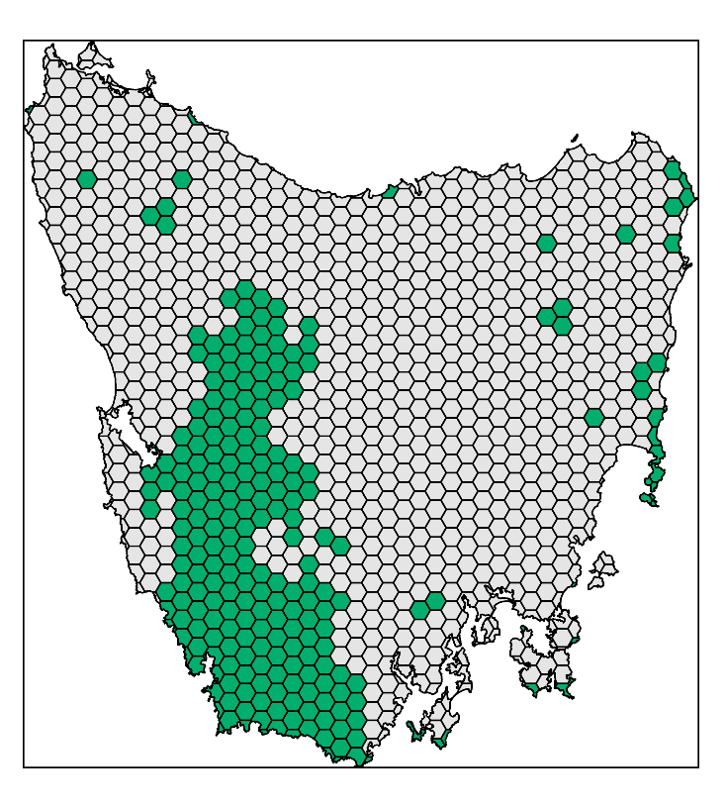
Design your problem
problem(tas_pu, tas_features,
"cost") %>%
add_min_set_objective() %>%
add_relative_targets(0.1) %>% add_locked_in_constraints("in") %>%
add_binary_decisions() %>%
add_gurobi_solver(gap = 0) %>% solve()

Slide 21
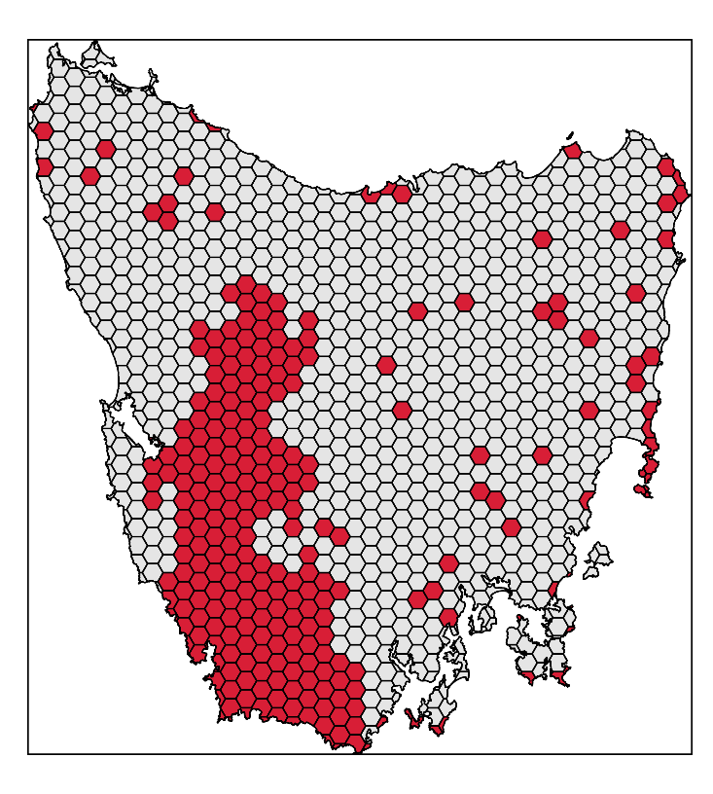
Design your problem
problem(tas_pu, tas_features,
"cost") %>%
add_min_set_objective() %>%
add_relative_targets(0.1) %>% add_locked_in_constraints("in") %>%
add_binary_decisions() %>%
add_gurobi_solver(gap = 0) %>% solve()

Slide 22
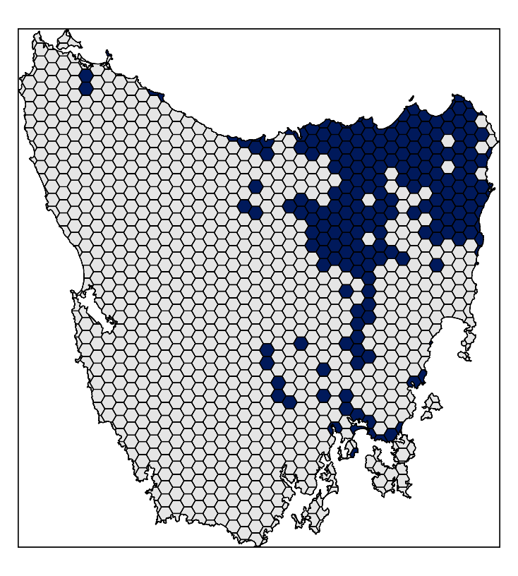
Design your problem
problem(tas_pu, tas_features,
"cost") %>%
add_min_set_objective() %>%
add_relative_targets(0.1) %>% add_locked_in_constraints("in") %>%
add_locked_out_constraints("out") %>%
add_binary_decisions() %>%
add_gurobi_solver(gap = 0) %>% solve()

Slide 23
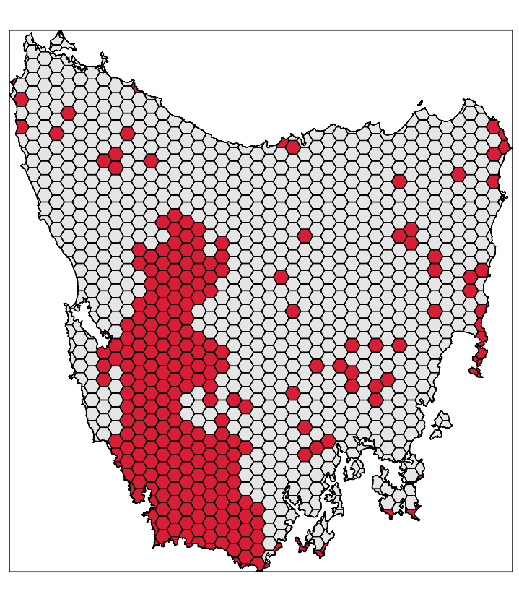
Design your problem
problem(tas_pu, tas_features,
"cost") %>%
add_min_set_objective() %>%
add_relative_targets(0.1) %>% add_locked_in_constraints("in") %>%
add_locked_out_constraints("out") %>%
add_binary_decisions() %>%
add_gurobi_solver(gap = 0) %>% solve()

Slide 24
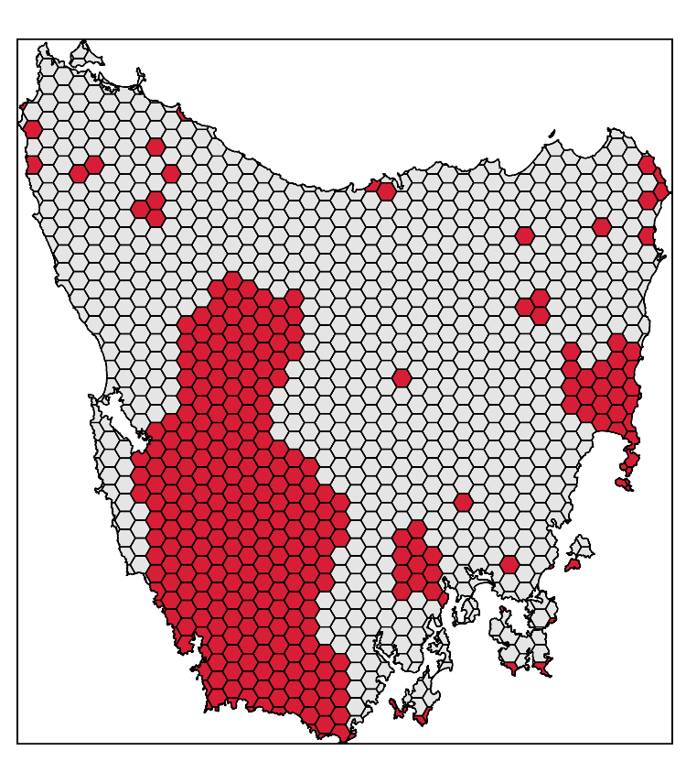
Design your problem
problem(tas_pu, tas_features,
"cost") %>%
add_min_set_objective() %>%
add_relative_targets(0.1) %>% add_locked_in_constraints("in") %>%
add_locked_out_constraints("out") %>%
add_boundary_penalties(0.01, 0.5) %>%
add_binary_decisions() %>%
add_gurobi_solver(gap = 0) %>% solve()

Slide 25
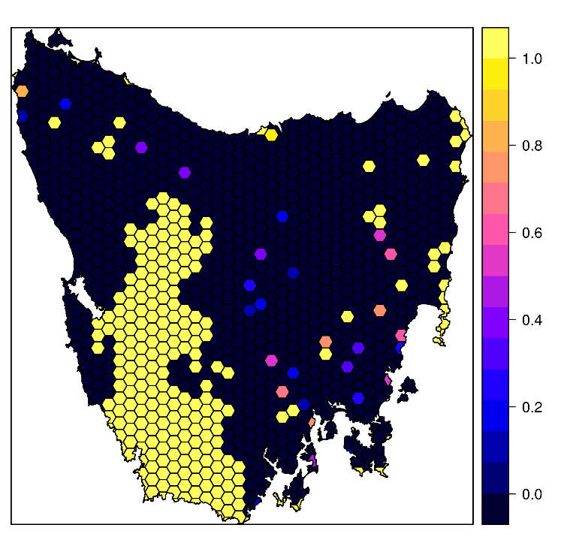
Design your problem
problem(tas_pu, tas_features,
"cost") %>%
add_min_set_objective() %>%
add_relative_targets(0.1) %>% add_locked_in_constraints("in") %>%
add_locked_out_constraints("out") %>%
add_proportion_decisions() %>%
add_gurobi_solver(gap = 0) %>% solve()

Slide 26
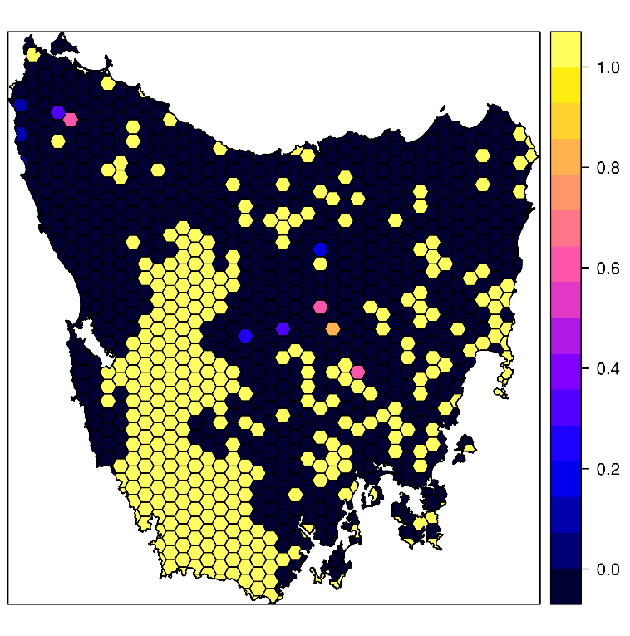
Design your problem
problem(tas_pu, tas_features,
"cost") %>%
add_max_features_objective(budget)%>%
add_relative_targets(0.1) %>% add_locked_in_constraints("in") %>%
add_locked_out_constraints("out") %>%
add_proportion_decisions() %>%
add_gurobi_solver(gap = 0) %>% solve()

Slide 27
What you will do today
Workshop manual section 5.
Generate prioritisations!
Answer questions in the manual
https://prioritizr.github.io/massey-workshop

Slide 28
Getting help
prioritizr website
https://prioritizr.net
RDocumentation
https://www.rdocumentation.org
Geocompr
https://geocompr.robinlovelace.net/

Slide 29



jeffrey.hanson@uqconnect.edu.au
github.com/prioritizr/prioritizr
prioritizr.net

